Slide 1

6.5 out of 10 people remember what they see…
Data Analysis and
Information Visualization
Term Project | CPSC 101 W23

Slide 2
Background
Class | Group A | Group B
Class 1 | 82 | 95
Class 2 | 76 | 88
Class 3 | 84 | 90
Data visualization is the practice of translating information into a visual context, such as a map or graph, to make data easier for the human brain to understand and pull insights from.
The main goal of data visualization is to make it easier to identify patterns, trends, and outliers in large data sets.

Slide 3
objectives
6.5 out of 10 people remember what they see…
To effectively communicate information in a universal manner using visual information
To pinpoint areas that need to be improved or need more attention
To help organizations in increased understanding of the next steps that must be taken
To help audience absorb information quickly, improve insights and make faster decisions

Slide 4
Blank slide
Term project
CPSC 101 W23

Slide 5
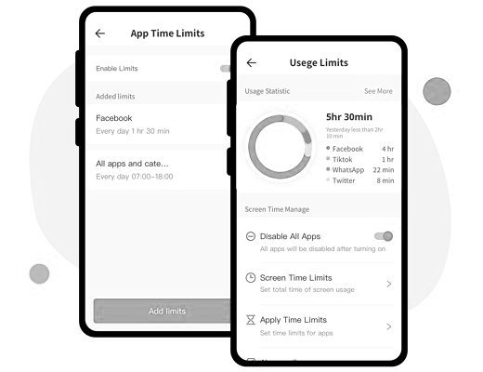
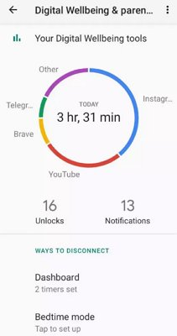
Social Media Screen Time analysis and Apps Usage distribution

Slide 6
Timeline and challenges
Phase A
Task 1
Phase B
Task 1
Phase C
Task 2
Task 2
Task 1
Task 2
Data set collection
Data validation and clean up
Coding, debugging and creating Jupyter notebook

Slide 7
Libraries used
Pandas and Numpy
Adds support for large, multi-dimensional arrays and matrices, along with a large collection of high-level mathematical functions
Seaborn
Pulls data out of HTML and XML files. Provides a high-level interface for drawing attractive and informative statistical graphics
Matplotlib
Comprehensive library for creating static, animated, and interactive visualizations in Python

Slide 8
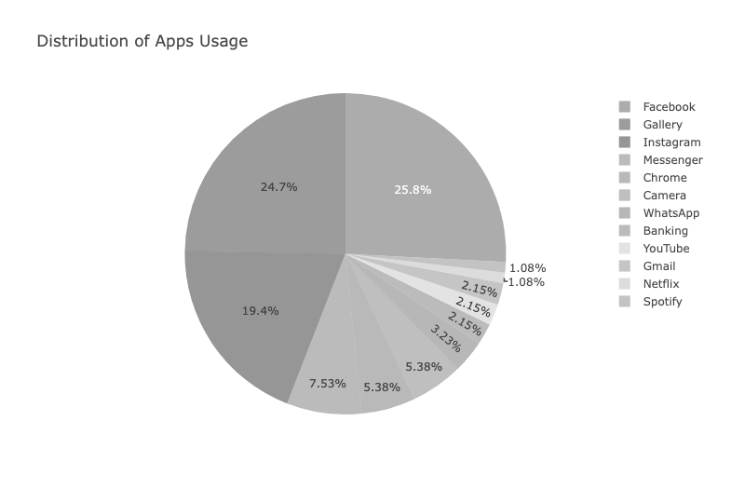
Jupyter notebook
import pandas as pd
import numpy as np
import plotly.express as px
import plotly.graph_objects as go
import seaborn as sns
import matplotlib.pyplot as plt
df = pd.read_csv ("file:///Users/jmulleda/Downloads/Social_Media.csv")

